Slide 1



FOREST FIRE PREDICTION SYSTEM
By K H HARSH
AICTE Student ID: STU687e65fb298581753114107
AICTE Internship ID: INTERNSHIP_17513641056863b20937d78

Slide 2

Learning Objectives
1) Understand Disaster Prediction
How meteorological factors like temperature, humidity, wind, and rain impact the risk and scale of forest fires.
The importance of early prediction for effective disaster management and safety.
2) Data Handling & EDA
Imported, cleaned, and preprocessed the forestfires.csv dataset.
Handled categorical data and normalized skewed data using log transformations.
Visualized patterns using matplotlib & seaborn to understand key fire-driving factors.
3) Machine Learning Models
Trained a Random Forest Regressor to predict the burned area of a fire.
Evaluated the model's performance and identified the most important predictive features.
4) Practical Application
Developed an interactive Streamlit web interface for real-time predictions.
Translated complex model outputs into an easy-to-understand risk assessment tool.
GOAL
Source :
https://github.com/Harsh-KH-6/Climate-Risk-and-Disaster-Mangement-AICTE.git

Slide 3
Tools and Technology Used
Programming Language:
Python
Tools:
Jupyter Notebook
GitHub (for version control)
CSV Dataset (forestfires.csv)
Libraries & Frameworks:
pandas → To load, clean, and preprocess the forest fire dataset.
numpy → For numerical operations and data transformation (log transformation).
matplotlib & seaborn → For data visualization (heatmaps, bar charts, scatter plots).
scikit-learn → To train and evaluate the Random Forest Regressor model.
streamlit → To build and deploy the interactive web application.
pickle → For model serialization and saving the trained model.
folium → To create the interactive geographical map of fire locations.

Slide 4
Methodology
1) Data Preprocessing and Feature Engineering
Loaded the forestfires.csv dataset and performed initial data exploration.
Converted categorical features (month, day) into numerical values for model compatibility.
Engineered a new feature, log_area, by applying a log transformation to the skewed area column to normalize its distribution.
2) Exploratory Data Analysis (EDA)
Generated a correlation heatmap to identify relationships between meteorological data and fire size.
Created various plots (scatter, bar) to visualize trends, such as the peak fire months (August, September) and days (weekends).
Developed an interactive geographical map with Folium to visualize the spatial distribution and magnitude of fires.
3) Model Training and Deployment
Selected 8 key features based on EDA for model training.
Split the dataset into an 80/20 train-test split.
Trained a Random Forest Regressor model on the training data.
Serialized the trained model as forest_fire_model.pkl for deployment.
Built an interactive Streamlit web application (app.py) with sidebar sliders for user input.
The app loads the model to provide real-time predictions and classifies fire risk as Low, Medium, or High.

Slide 5
Problem Statement:
Forest fires pose a significant and growing threat to ecosystems, property, and human lives, exacerbated by climate change. Effective disaster management relies on the ability to predict the potential scale of a fire before it spreads.
The challenge is to develop a predictive model that can accurately estimate the burned area of a forest fire using readily available meteorological data. This requires analyzing environmental factors such as temperature, humidity, and wind speed to identify key predictors.
GITHUB LINK:
https://github.com/Harsh-KH-6/Climate-Risk-and-Disaster-Mangement-AICTE

Slide 6
Solution:
Successfully trained a Random Forest Regressor model with good predictive accuracy on the test data.
The model uses 8 key features (Temperature, RH, Wind, Rain, FFMC, DMC, DC, ISI) to make predictions.
Developed a real-time Streamlit interface where users can input environmental data and receive an instant fire area prediction.
The application provides a clear risk assessment (Low, Medium, High) based on the predicted burned area.
https://github.com/Harsh-KH-6/Climate-Risk-and-Disaster-Mangement-AICTE

Slide 7
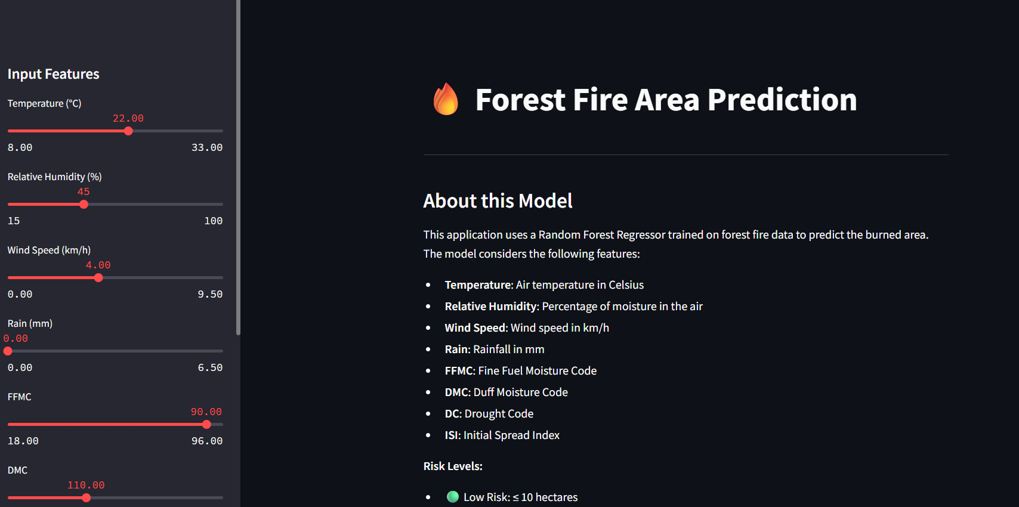
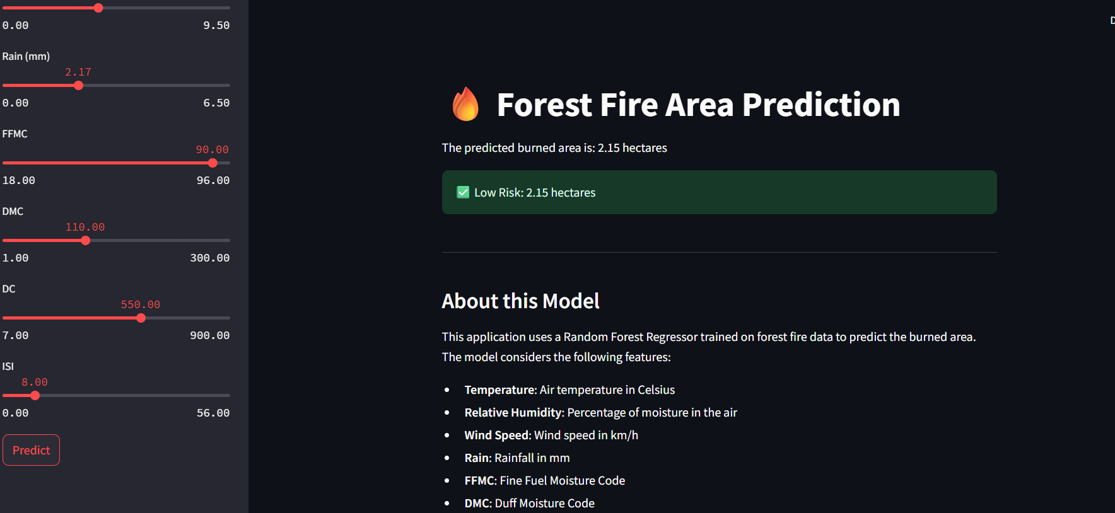

Screenshot of Output:

Slide 8
Conclusion:
This project successfully demonstrates the application of machine learning to predict the scale of forest fires using key meteorological factors. By training a Random Forest Regressor, the model showed promising results in identifying potential fire risks based on environmental conditions.
Through data preprocessing, exploratory data analysis, and model deployment, this project highlights how data-driven approaches can significantly improve disaster management. The interactive Streamlit interface makes the system practical for real-time risk assessment, providing a valuable tool for emergency services and public awareness.
In conclusion, this project shows that artificial intelligence is a powerful asset in mitigating the impact of natural disasters. By predicting the potential size of forest fires with reasonable accuracy, it can help authorities make informed decisions about resource allocation and public safety, ultimately contributing to better preparedness and resilience against one of the major threats posed by climate change.

